Slide 1

Ransomware study - 2

Slide 2
Botnet Reference - Your Botnet is My Botnet: Analysis of a Botnet Takeover
The main idea behind this paper is to define an understanding of Botnet and how it can be used to steal personal information and signify what kind of personal information is being stolen.
This study is carried out on Torpig Botnet.
Torpig uses domain flux to actively locate C&C servers.

Slide 3
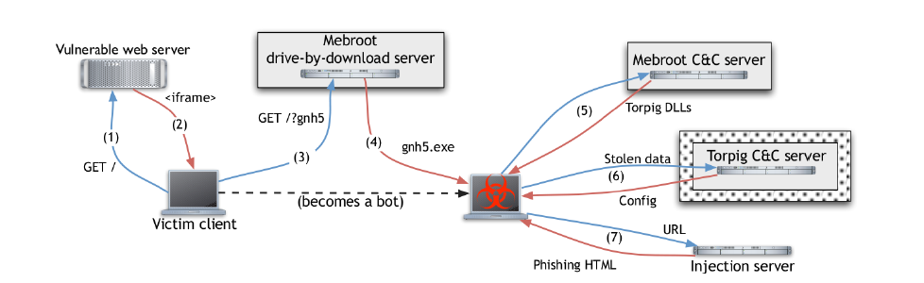
Torpig Network infrastructure

Slide 4
How did they took control of the botnet
They did this by registering domains that the bots would use to connect to their Command & Control (C&C) server. They also set up a data collection infrastructure to monitor the botnet's activity. However, the botmasters behind Torpig released a new version of the malware that changed the way the domain algorithm worked, which made it difficult for the authors to maintain control.
To prepare for sinkholing (taking control of the botnet), the authors purchased services from unresponsive hosting providers and registered domains with multiple registrars to ensure redundancy. They also set up an Apache web server to receive and log bot requests, and recorded all network traffic. They were able to collect over 8.7GB of Apache log files and 69GB of pcap data during the ten days they controlled the botnet.

Slide 5
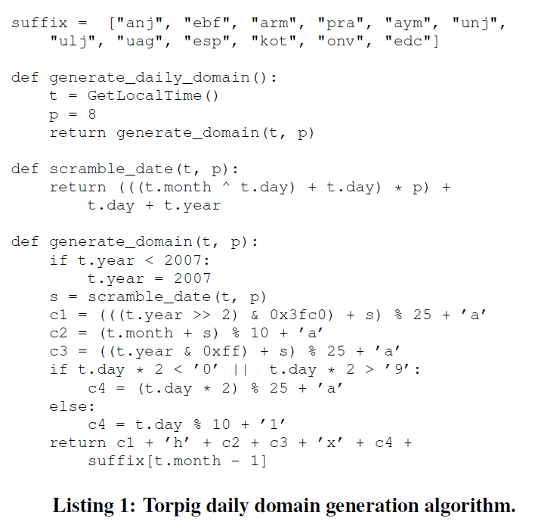
How torpig generated domain names in domain flux

Slide 6
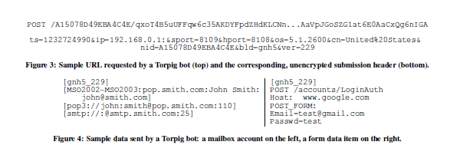
Sample of data transmitted by a torpig bot

Slide 7
Financial data stealing
Torpig is a type of malware that is designed to steal valuable financial information, like bank account and credit card numbers, which can be sold on the black market. It targets banks and financial institutions through phishing attacks, and in 10 days it obtained the credentials of over 8,000 accounts at 410 different institutions. Torpig also collects credit card data, and in 10 days it extracted 1,660 unique credit and debit card numbers. The value of this stolen information on the black market is uncertain, but it could be worth anywhere between $83,000 to $8.3 million. Torpig continuously produces new financial information for its controllers during its activity.

Slide 8
Socks proxy and dos
Torpig malware opens two ports on the infected computer, which can be used by attackers to send spam or browse the internet anonymously. About 20% of the infected machines were accessible from the internet, meaning that attackers could easily use them for malicious purposes. The authors checked the 10,000 most frequently contacting IPs and found that one was a verified spam source and 244 had open proxies used for spamming or were infected with spam-related malware. Although it is not clear if Torpig caused these IPs to be on the spam blocklist, it is clear that the malware can drag its victims into various malicious activities.

